Slide 1
API DYNAMIC VALIDATION

Slide 2

Two Ways
Joi
Express-Joi-validator

Slide 3
What is Joi?
Joi was originally built by Hapi.js team as a plugin to support object schema validation within the Hapi framework.
JavaScript input validation library
It provides body, query and URL params validation in Hapi.js.
Adding validation is as simple as calling the right method.
It also supports validation on deeply nested objects

Slide 4
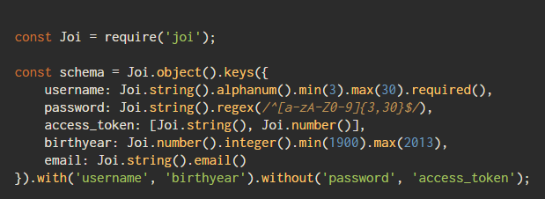
Joi schemas
Joi uses schemas to define validation rules and constraints for data.
https://github.com/hapijs/joi/blob/v10.6.0/API.md

Slide 5
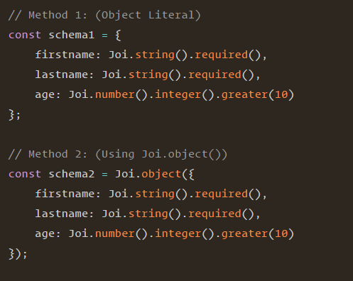
Schema structures
Object schema
Joi.object( ) or Joi.object.keys( )
When using any of these two methods, you can further control the keys that are allowed in the object using some additional constraints, which will not be possible to do using the object literal method.

Slide 6
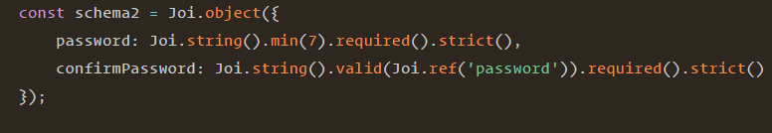
Schema structures…
Using Key References

Slide 7
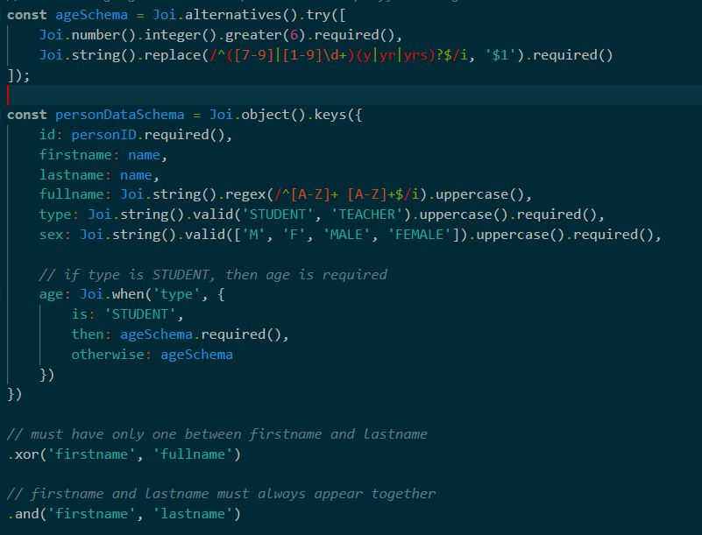
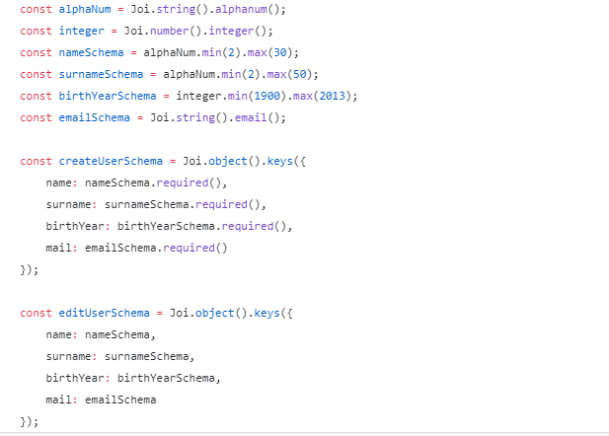
Schema structures…
Reusable schemas

Slide 8
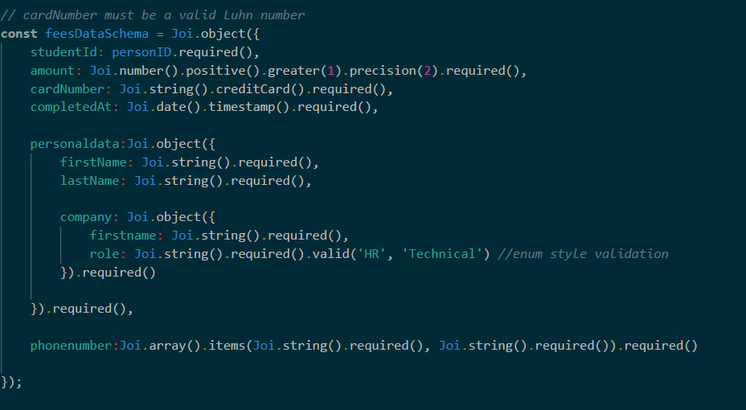
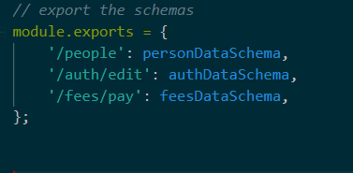
Supports nested object schema declaration
Created schemas for our API endpoints
and exported them in an object
with the endpoints as keys

Slide 9
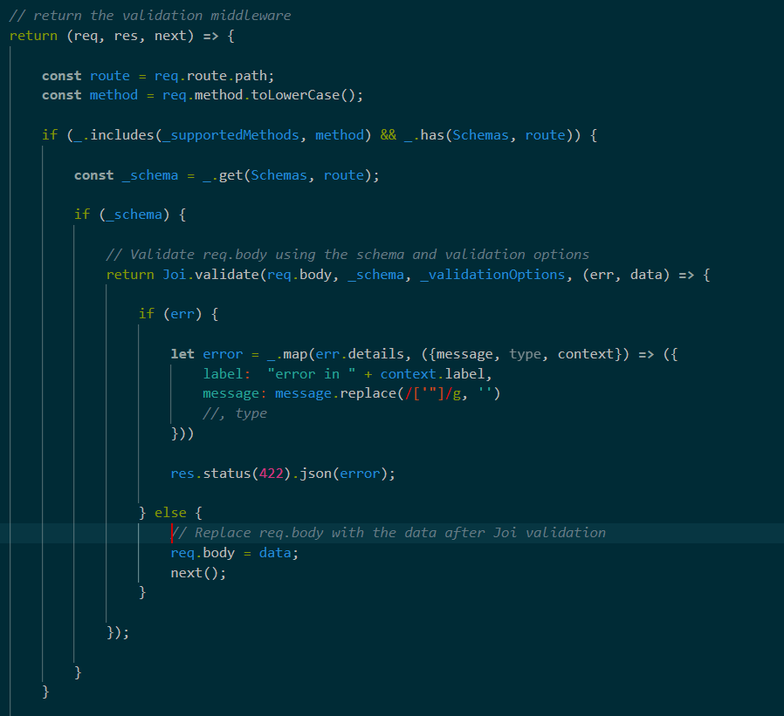
Schema Validation Middleware
(middleware / SchemaValidator.js)
The validation is done using the Joi. validate() Method, with the following signatures:
Data → ( req .body )
Schema → ( _schema )
Options →
( _validation Options )
Callback → ( err , data )

Slide 10
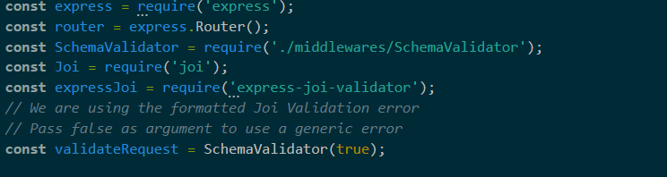
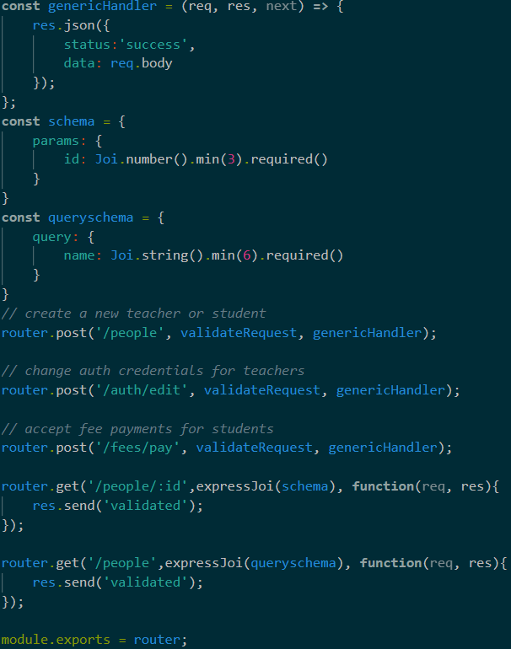
Use the middleware on our routes ( routes.js )
Express-joi-validator
Use params , query , body keywords for validation
Const schema =
{
params:{…},
body:{…},
query:{…}
}
Throw only one error at a time

Slide 11
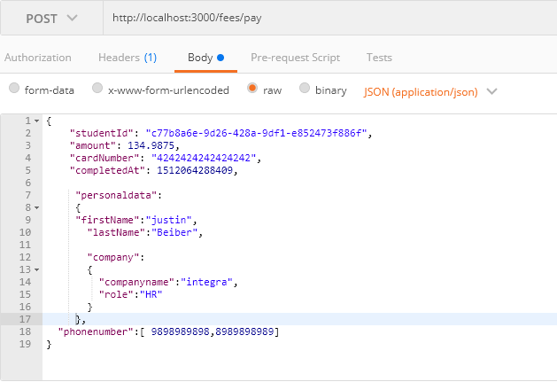
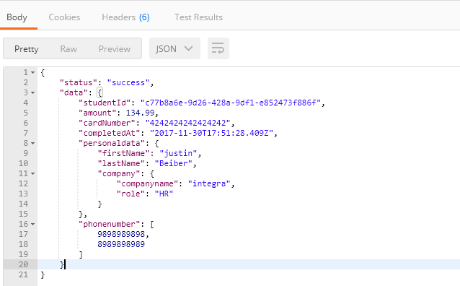
Post request

Slide 12
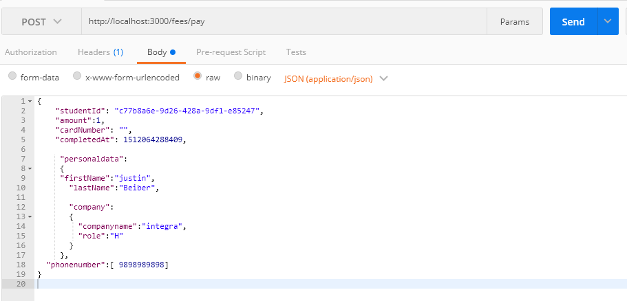
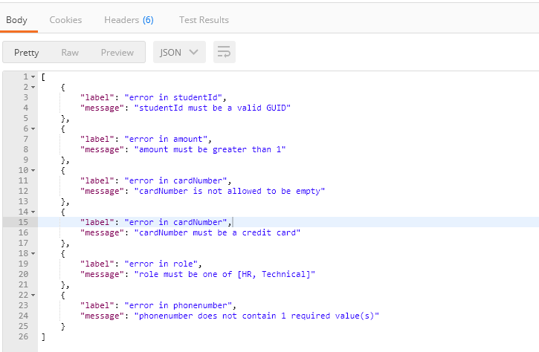
Post request…

Slide 13
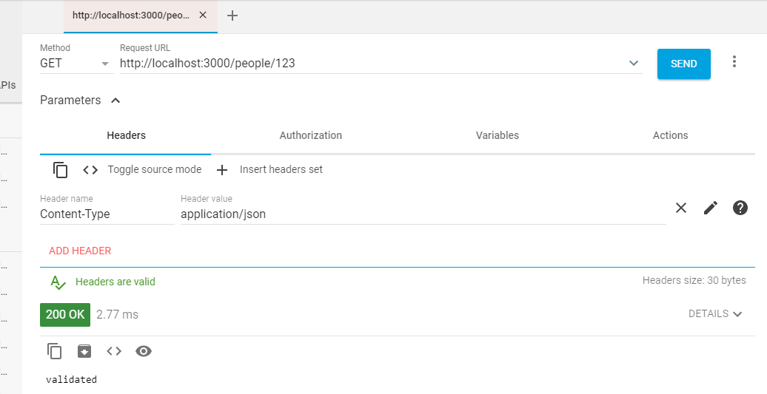
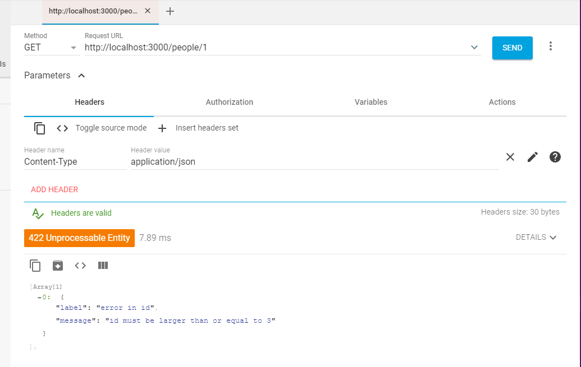
Get request (params)

Slide 14
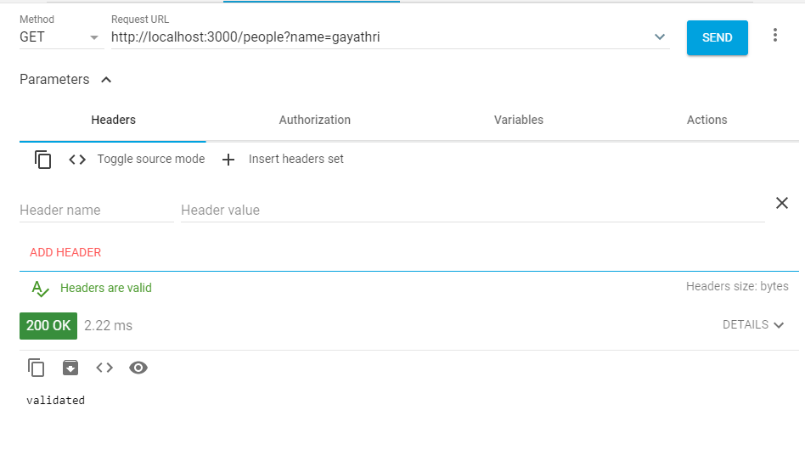
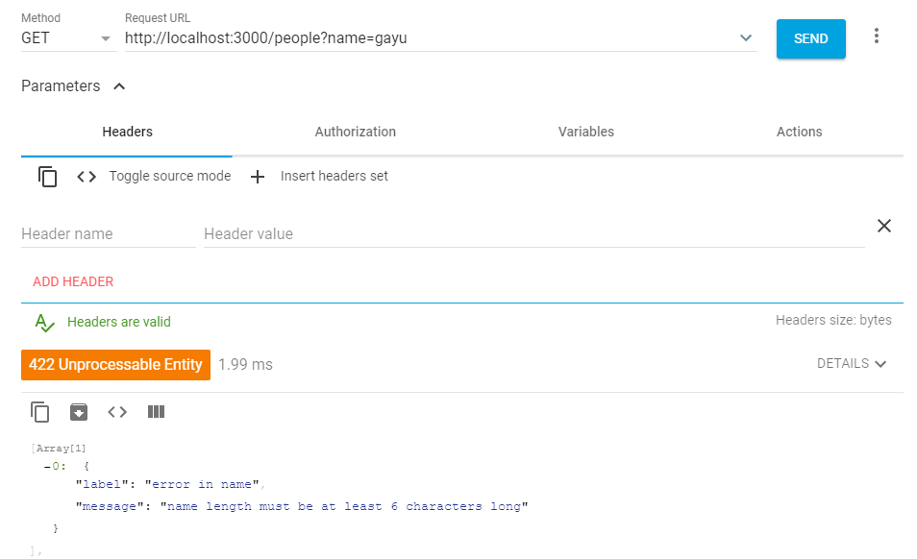
Get request (query)

Slide 15
JOI Advantages
Share json schema between frontend /backend
Frontend
https://github.com/jiffbski/Joi-browser
Backend
https://github.com/hapi.js/Joi
Validated at entry point
Much safer than validation through database

